Slide 1
Energy-aware Scheduling
국민대학교 임베디드 연구실
경 주 현
2017 LG MC 인재육성팀 교육

Slide 2
Outline
Summarize two documents
“Energy-aware Scheduling”
“EAS Overview and Integration Guide”

Slide 3
Motivation
Hardware topologies are becoming more varied
accommodating different power/performance budgets:
SMP, multi-cluster SMP, ARM big.LITTLE technology.
Per core/per cluster DVFS
Linux power management frameworks are uncoordinated
Hard to tune for different topologies.

Slide 4
Power Saving Scheduling
Measure all CPUs’ load
Choose a CPU from available CPUs
Decide the idlest CPU
Migrate tasks from the idlest CPU to the chosen CPU

Slide 5
State of the art document for EAS.
"Energy Aware Scheduling", Byungchul Park, LG Electronic
“EAS Overview and Integration Guide”, ARM

Slide 6
"Energy Aware Scheduling",
Byungchul Park,
LG Electronic
reference link: Linux Foundation Events

Slide 7
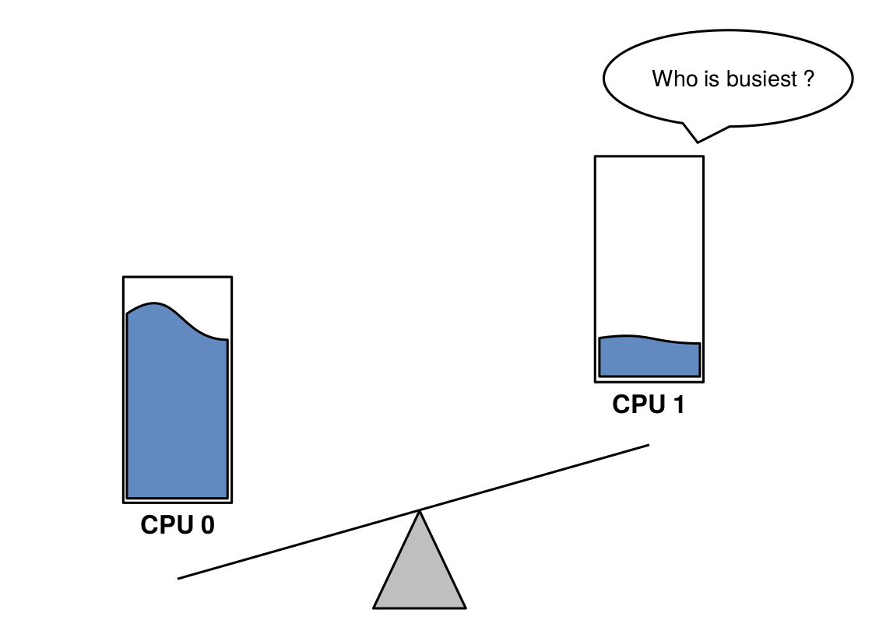
Load Balancing - migration
"Energy Aware Scheduling", Byungchul Park, LGE

Slide 8
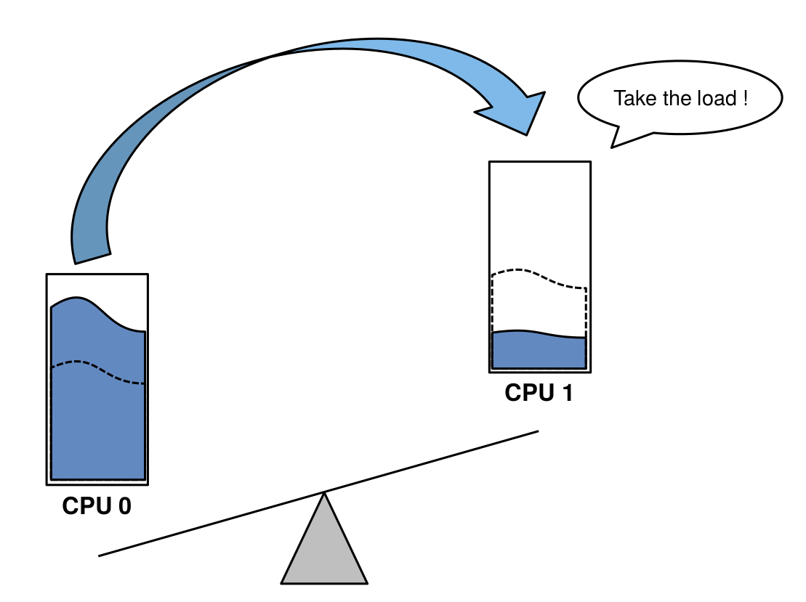
Load Balancing - migration
"Energy Aware Scheduling", Byungchul Park, LGE

Slide 9
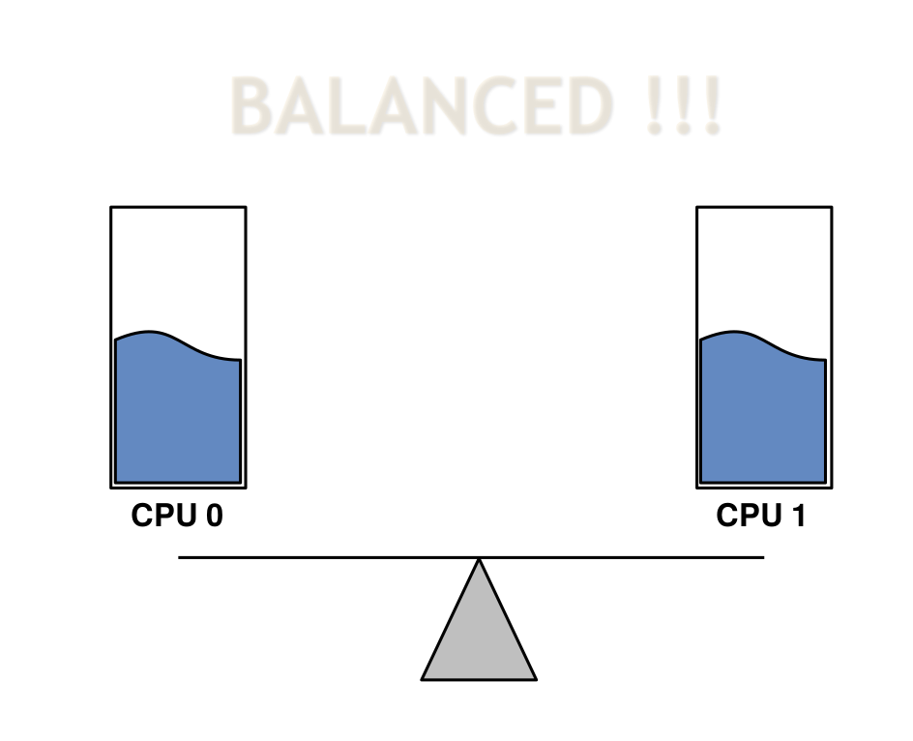
Load Balancing - migration
"Energy Aware Scheduling", Byungchul Park, LGE

Slide 10
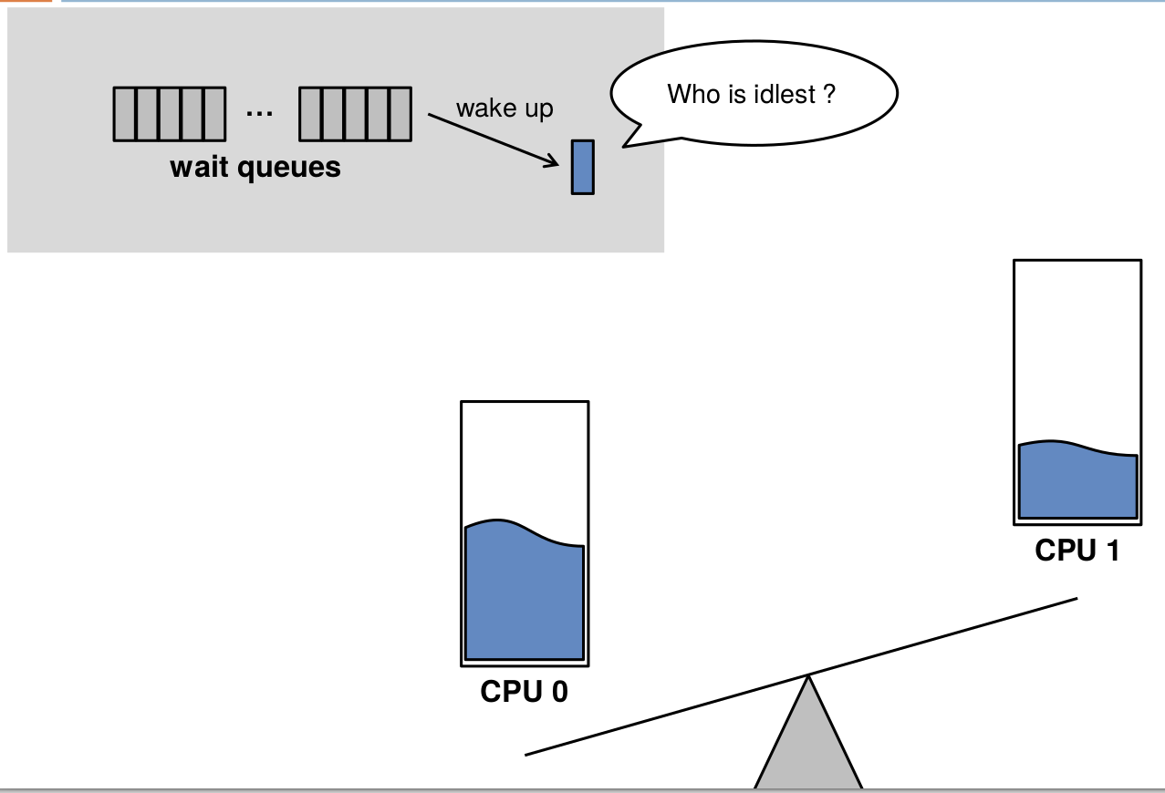
Load Balancing - wake-up
"Energy Aware Scheduling", Byungchul Park, LGE

Slide 11
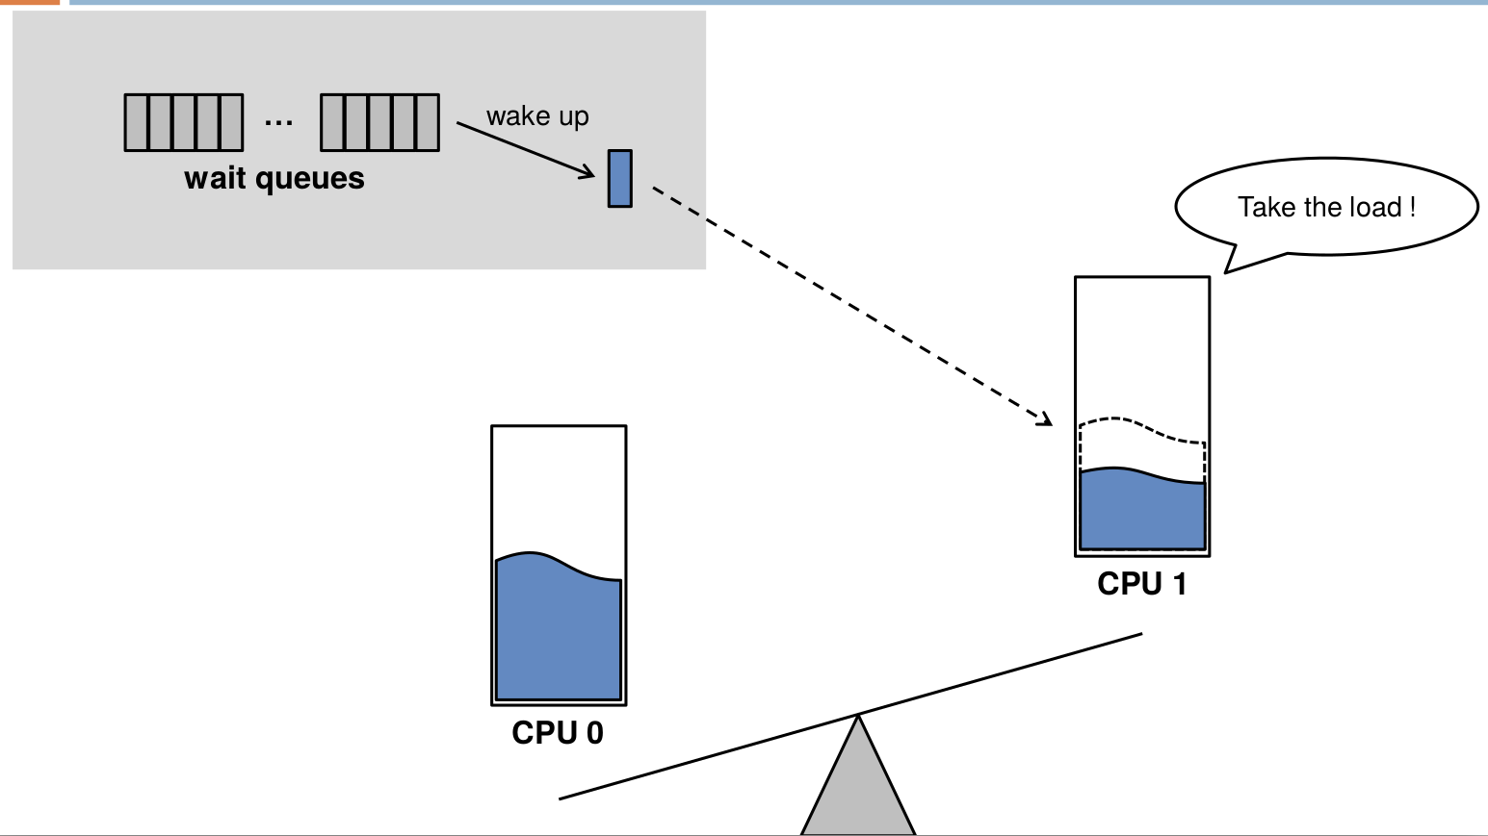
Load Balancing - wake-up
"Energy Aware Scheduling", Byungchul Park, LGE

Slide 12
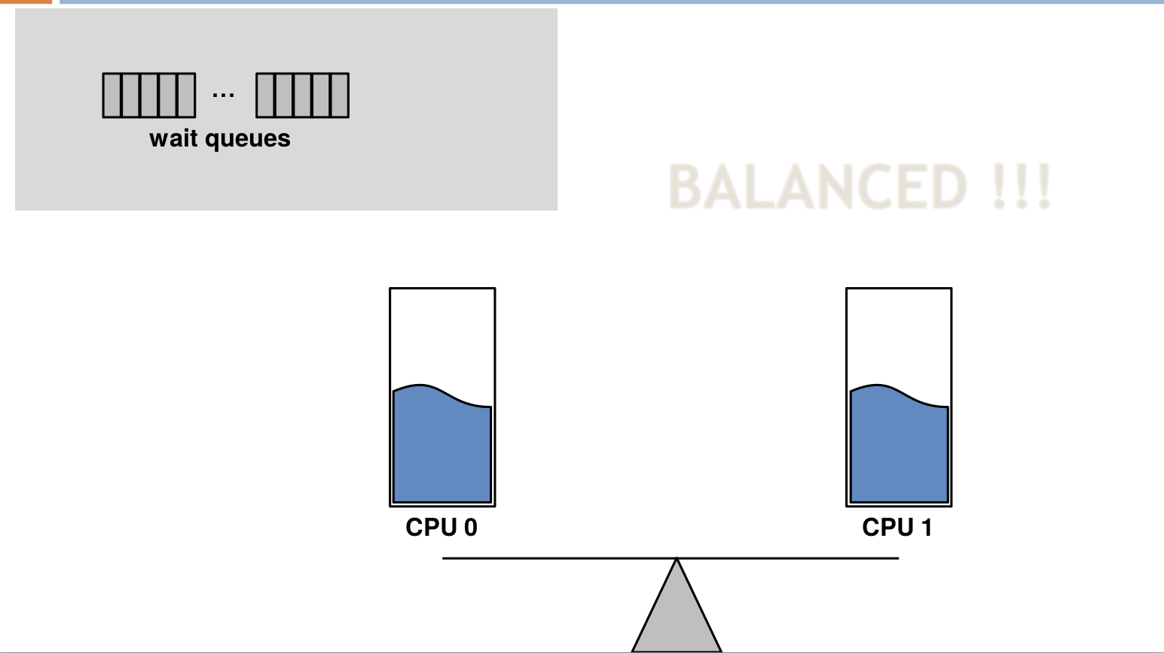
Load Balancing - wake-up
"Energy Aware Scheduling", Byungchul Park, LGE

Slide 13
Problem
Only focused on performance
Spreading approach
Guarantee maximum performance and minimum latency

Slide 14
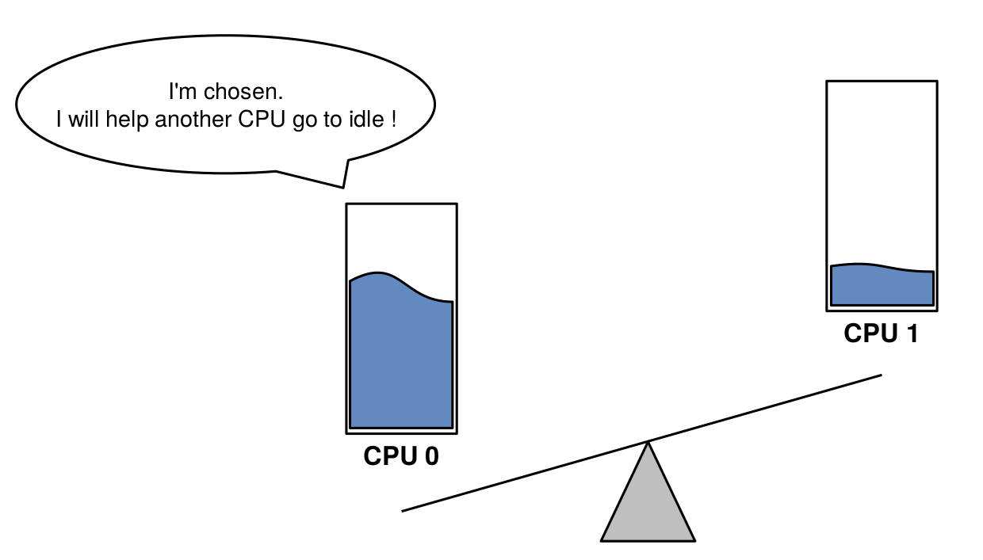
Power Saved Load Balancing - migration
"Energy Aware Scheduling", Byungchul Park, LGE

Slide 15
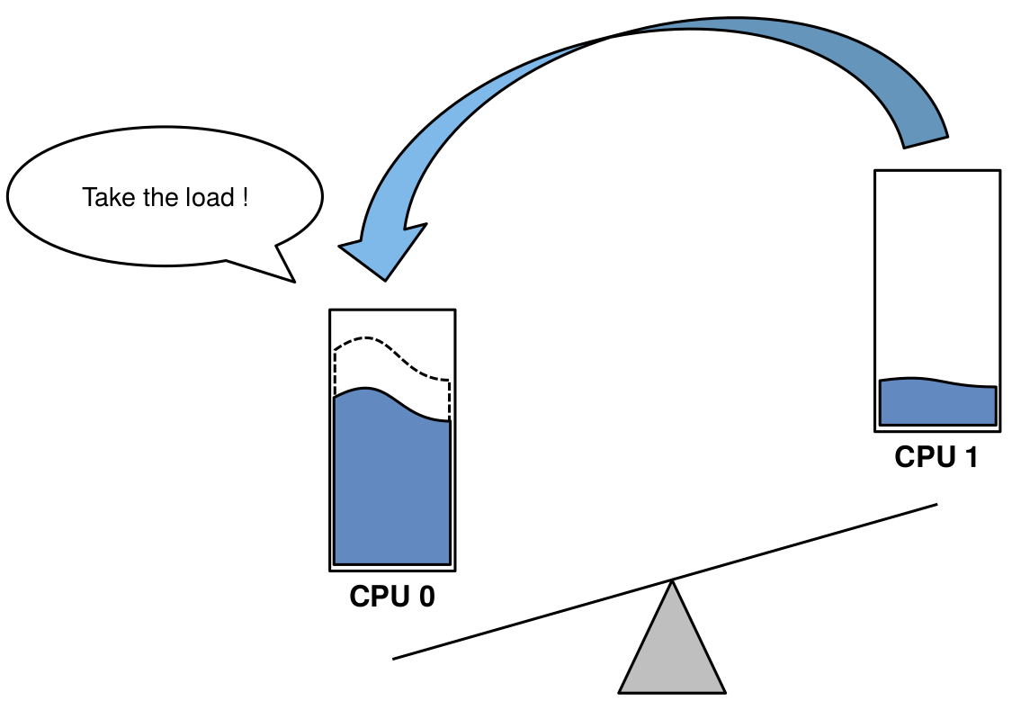
Power Saved Load Balancing - migration
"Energy Aware Scheduling", Byungchul Park, LGE

Slide 16
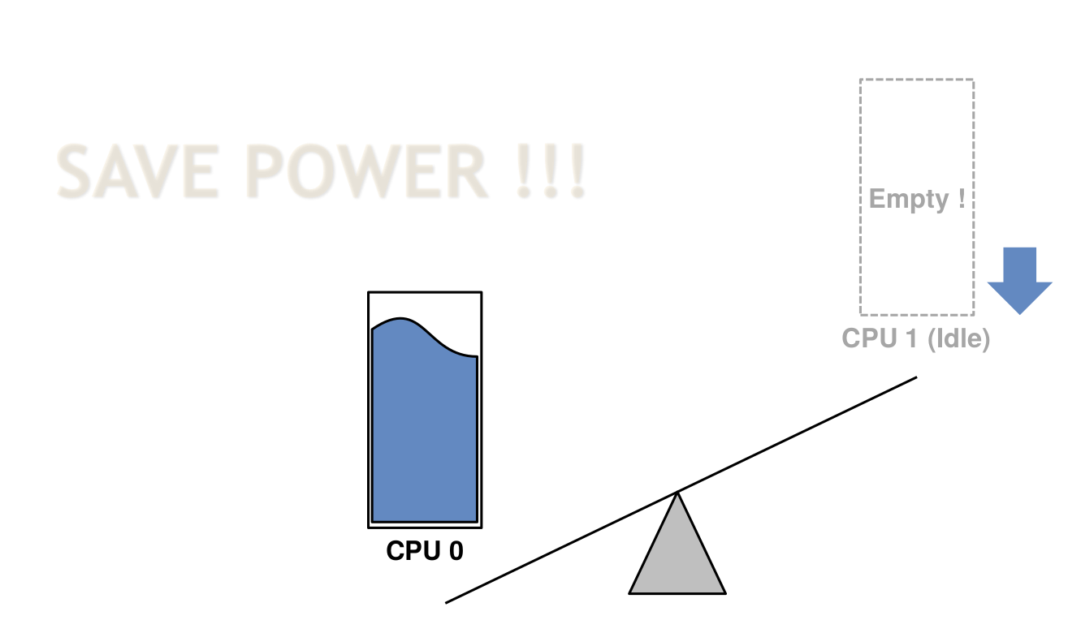
Power Saved Load Balancing - migration
"Energy Aware Scheduling", Byungchul Park, LGE

Slide 17
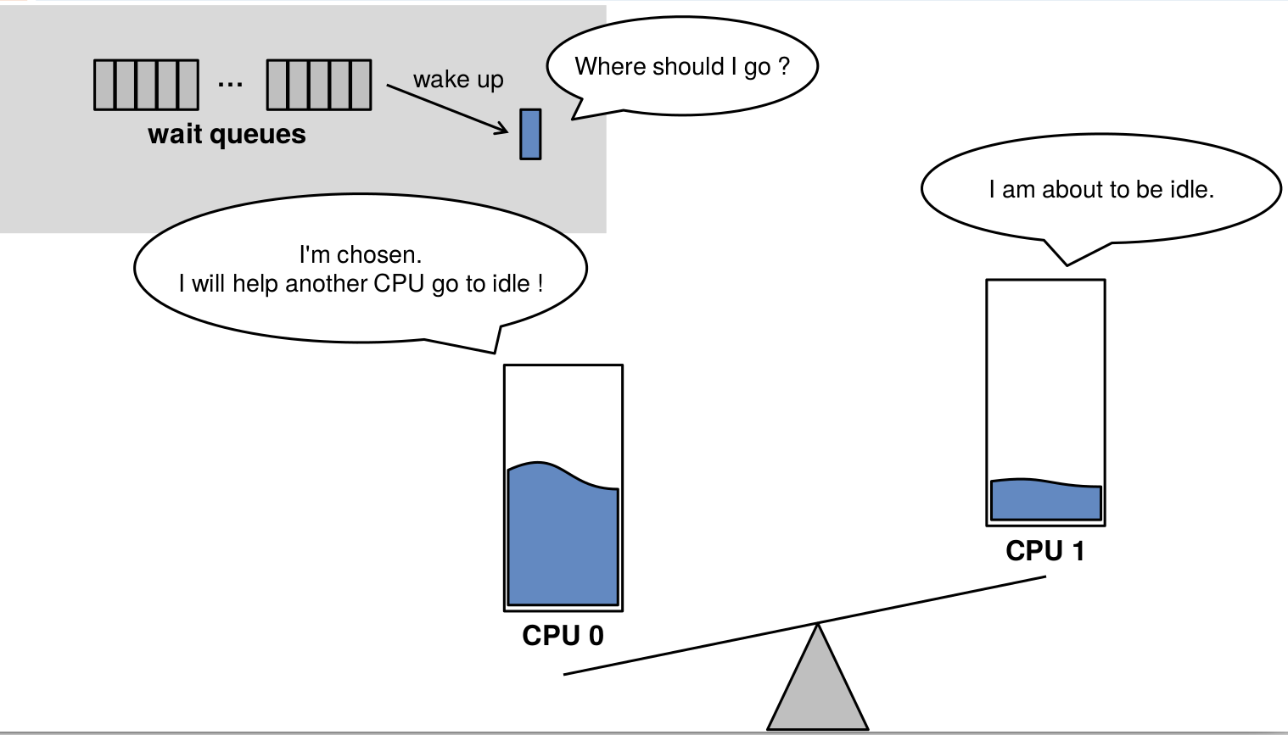
Power Saved Load Balancing - wake-up
"Energy Aware Scheduling", Byungchul Park, LGE

Slide 18
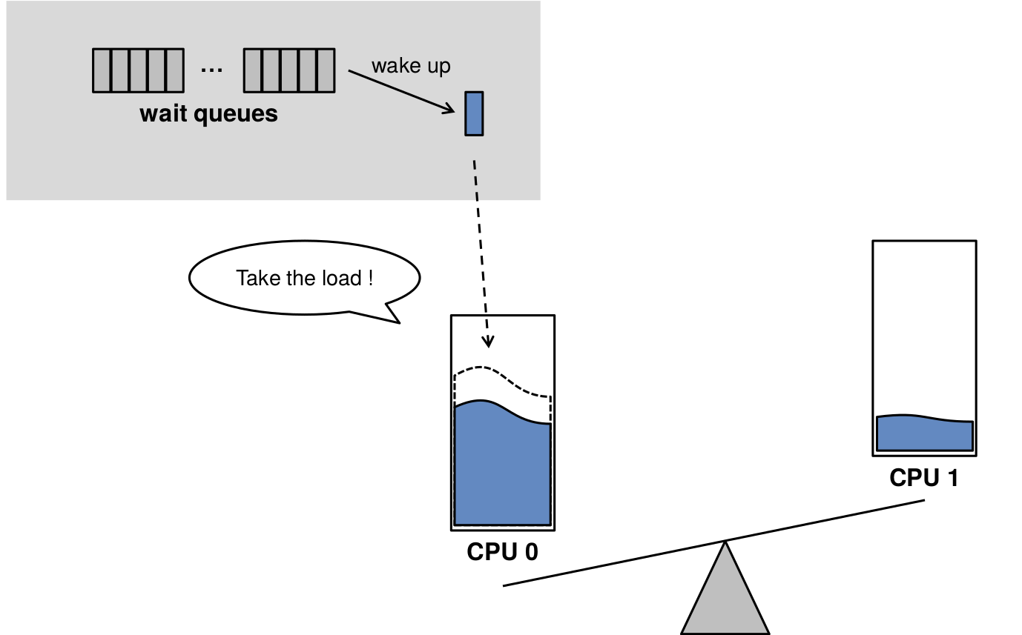
Power Saved Load Balancing - wake-up
"Energy Aware Scheduling", Byungchul Park, LGE

Slide 19
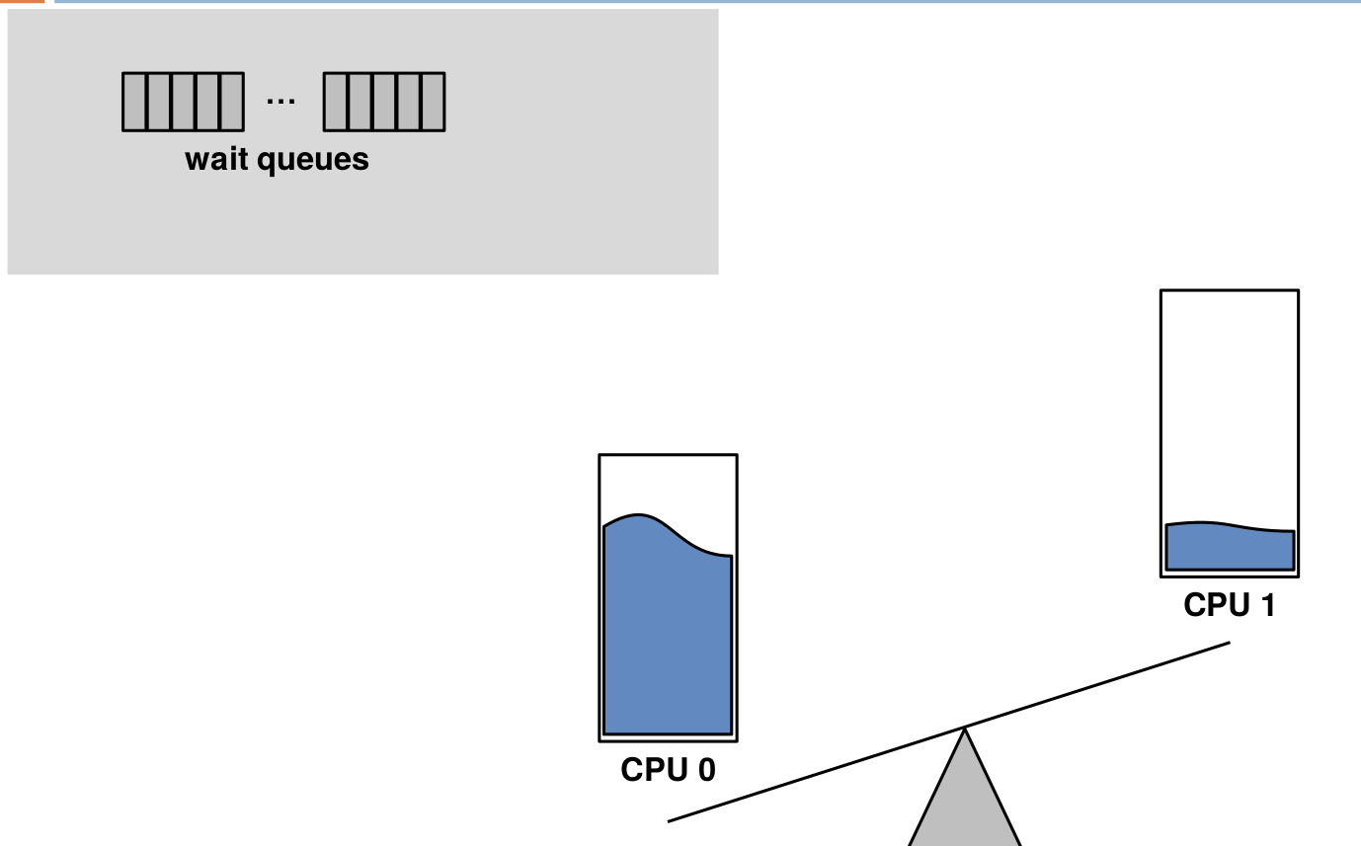
Power Saved Load Balancing - wake-up
"Energy Aware Scheduling", Byungchul Park, LGE

Slide 20
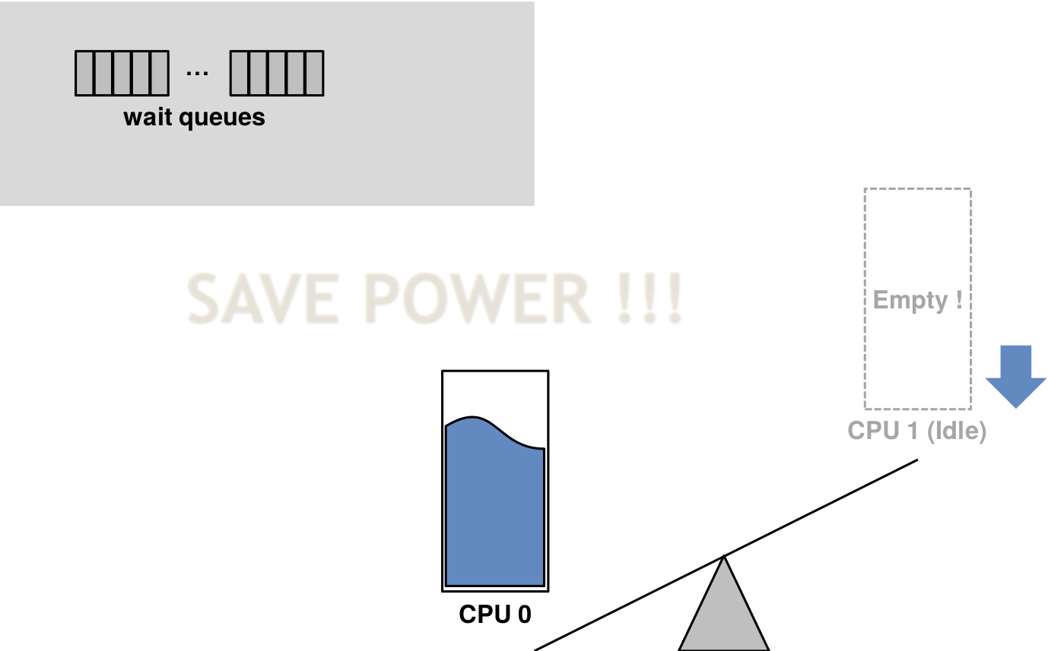
Power Saved Load Balancing - wake-up
"Energy Aware Scheduling", Byungchul Park, LGE

Slide 21
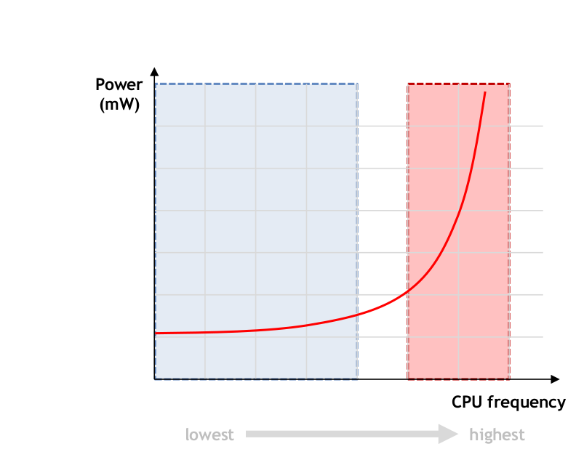
Problem
Frequency
"Energy Aware Scheduling", Byungchul Park, LGE

Slide 22
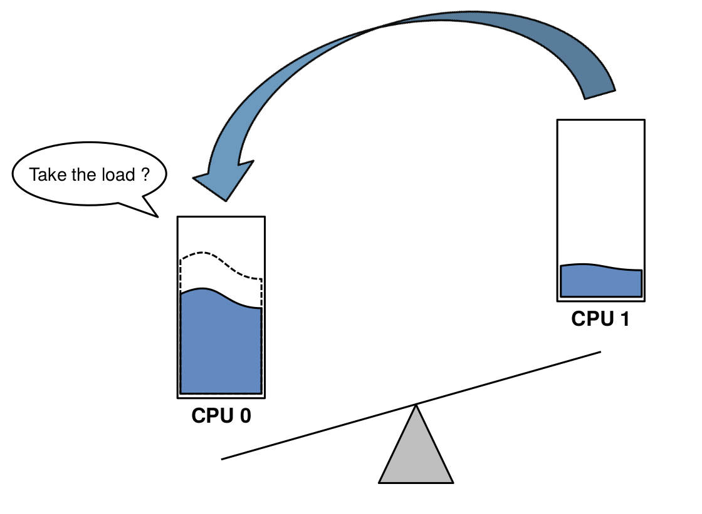
Problem - Frequency
"Energy Aware Scheduling", Byungchul Park, LGE

Slide 23
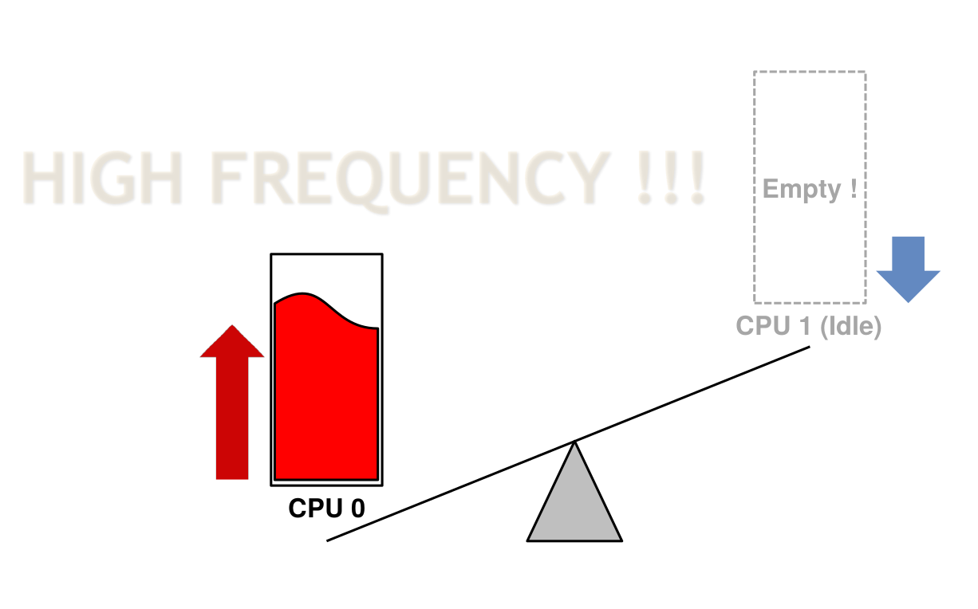
Problem - Frequency
"Energy Aware Scheduling", Byungchul Park, LGE

Slide 24
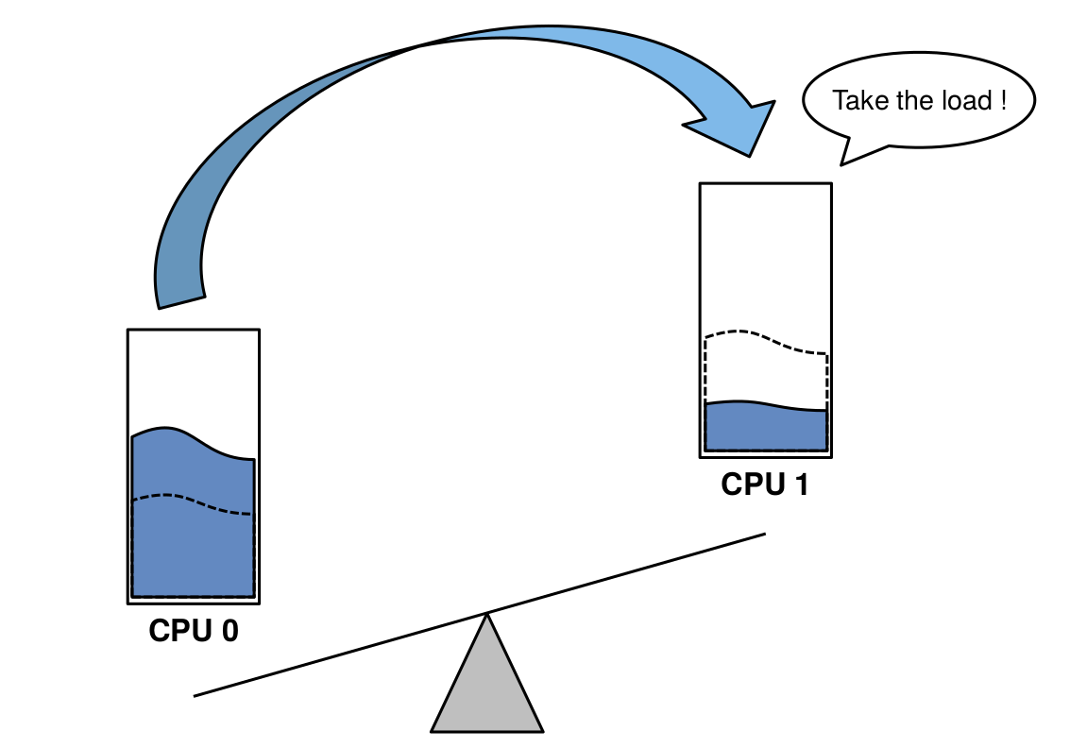
Solution
"Energy Aware Scheduling", Byungchul Park, LGE

Slide 25
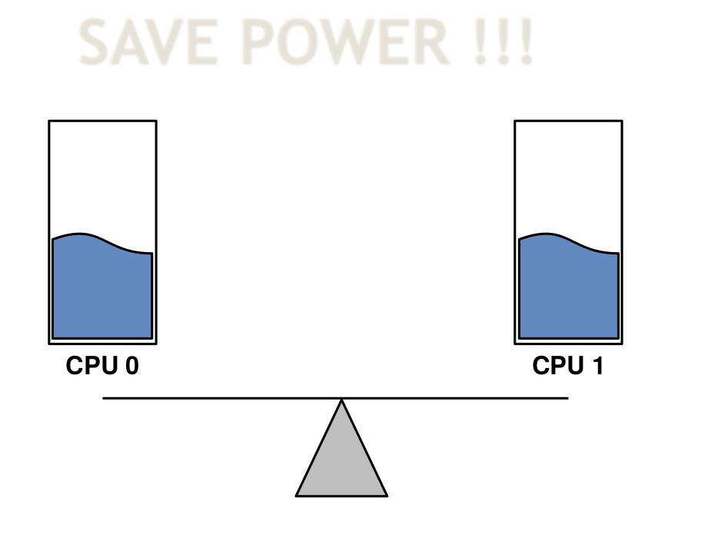
Solution
"Energy Aware Scheduling", Byungchul Park, LGE

Slide 26
Problem 1
CPU idle? CPU frequency ?
"Energy Aware Scheduling", Byungchul Park, LGE

Slide 27
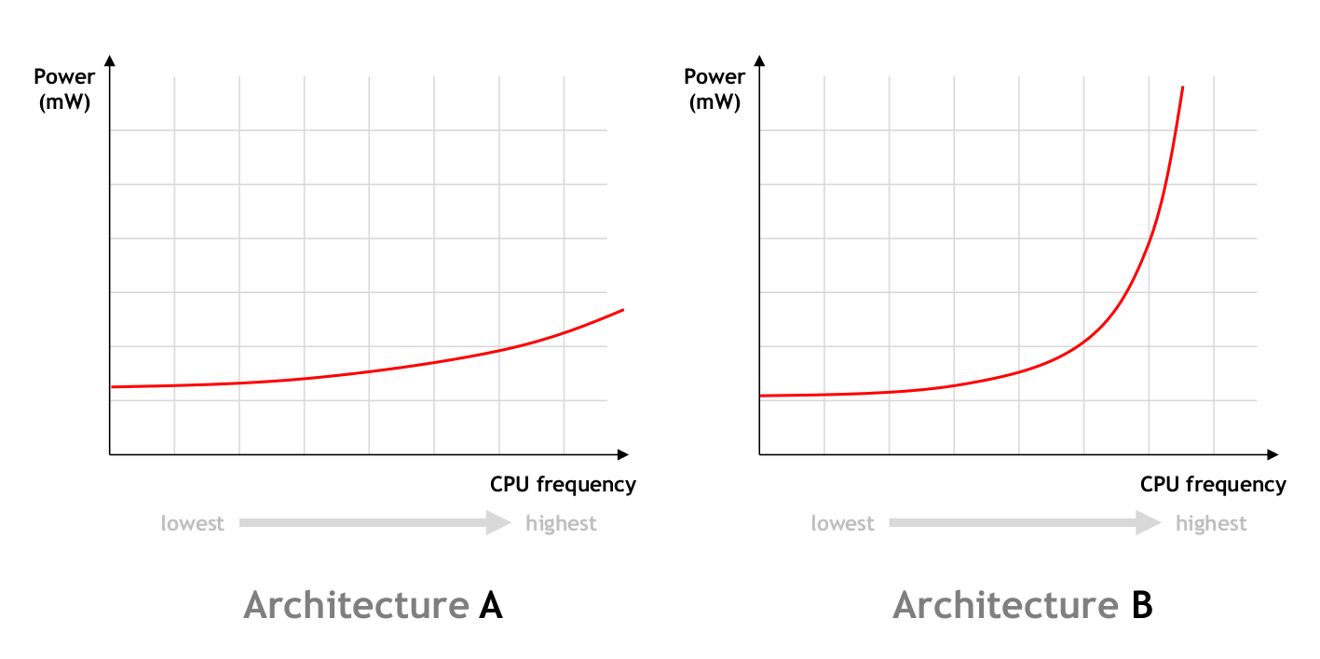
Problem 2
Architecture A? Architecture B?
"Energy Aware Scheduling", Byungchul Park, LGE

Slide 28
Solution
Use Energy Cost Model
For saving power consumption,
Is it better to pack tasks to fewer CPUs ?
Is it better to spread tasks to all CPUs ?

Slide 29
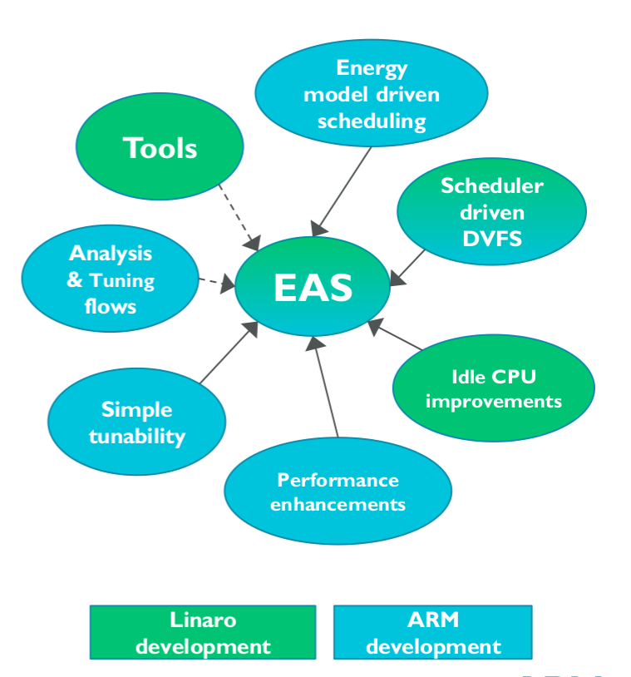
Solution

Slide 30
"EAS Overview and Integration Guide”
ARM

Slide 31
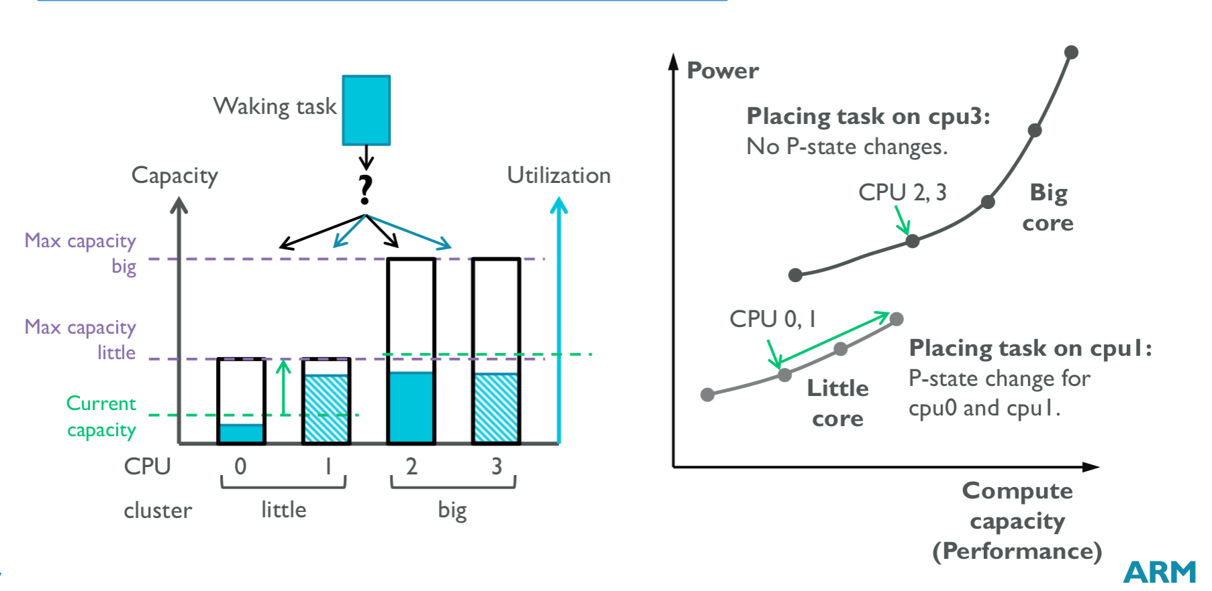
What is EAS – the energy model
“EAS Update” 2015 september ARM

Slide 32
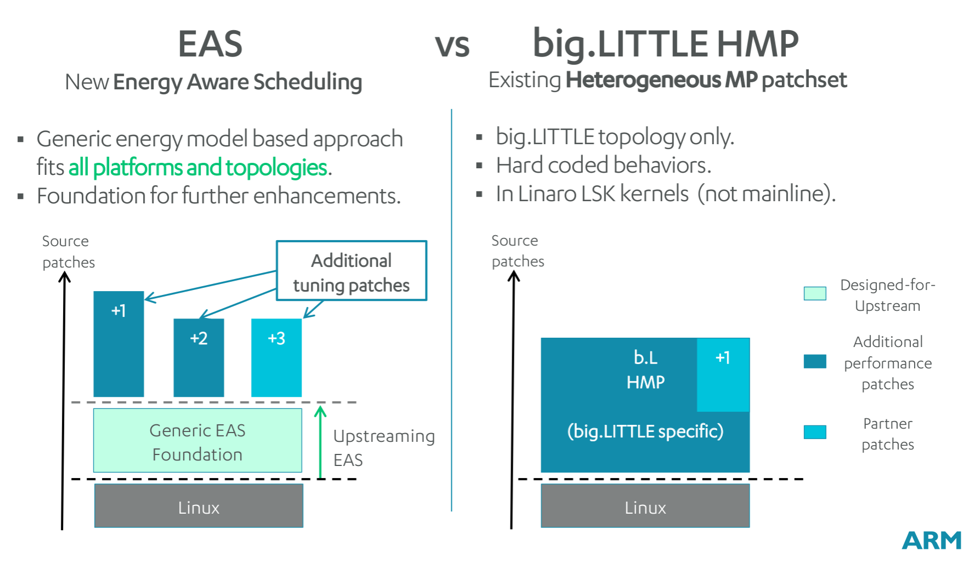
EAS vs big.LITTLE HMP(GTS)
“EAS Update” 2015 september ARM

Slide 33
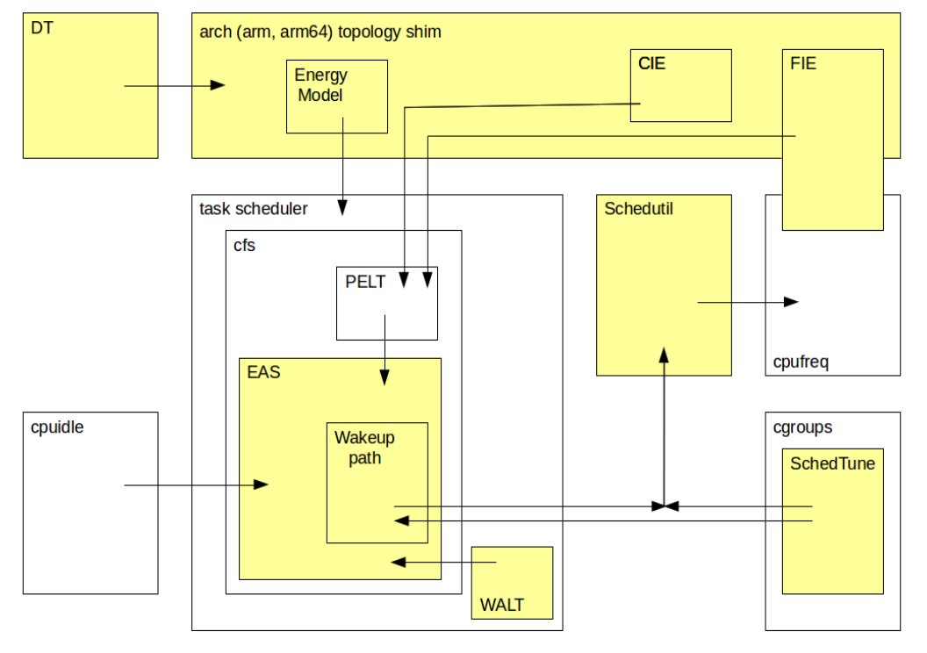
EAS building blocks
"EAS Overview and Integration Guide”, ARM TR

Slide 34
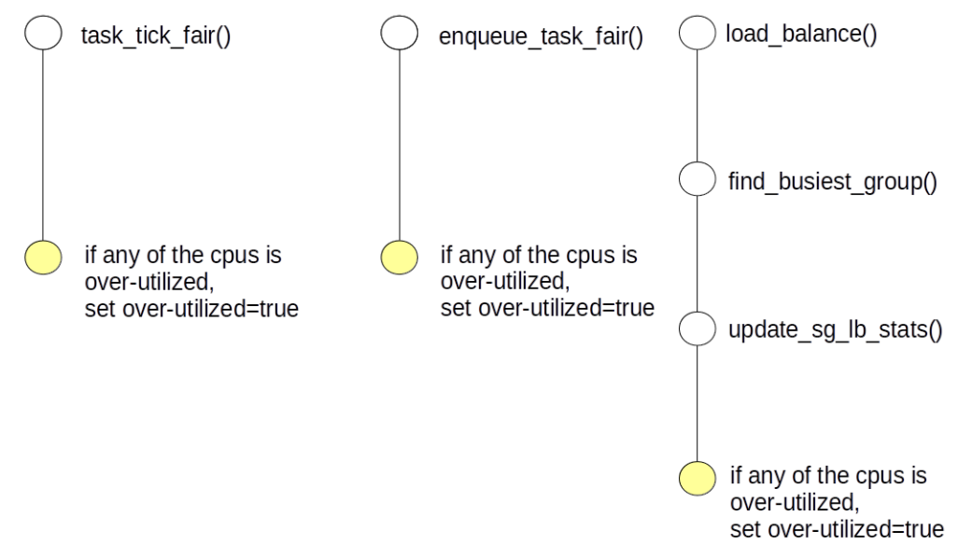
Over-utilized
"EAS Overview and Integration Guide”, ARM TR

Slide 35
cpu_overutilized
static bool cpu_overutilized(int cpu)
{
return (capacity_of(cpu) * 1024) < (cpu_util(cpu) * capacity_margin);
}
capacity_margin = capacity_margin = 1280; /* ~20% margin */
cpu_util = static inline unsigned long __cpu_util(int cpu, int delta)
{
unsigned long util = cpu_rq(cpu)->cfs.avg.util_avg;
}

Slide 36
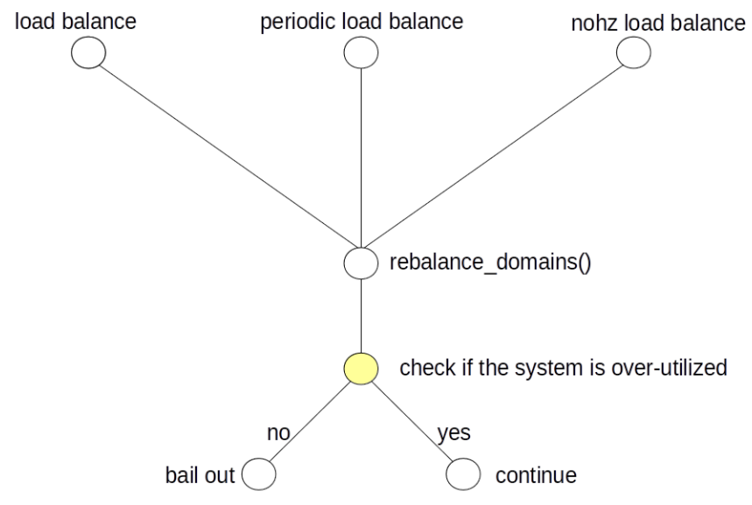
over-utilized
"EAS Overview and Integration Guide”, ARM TR

Slide 37
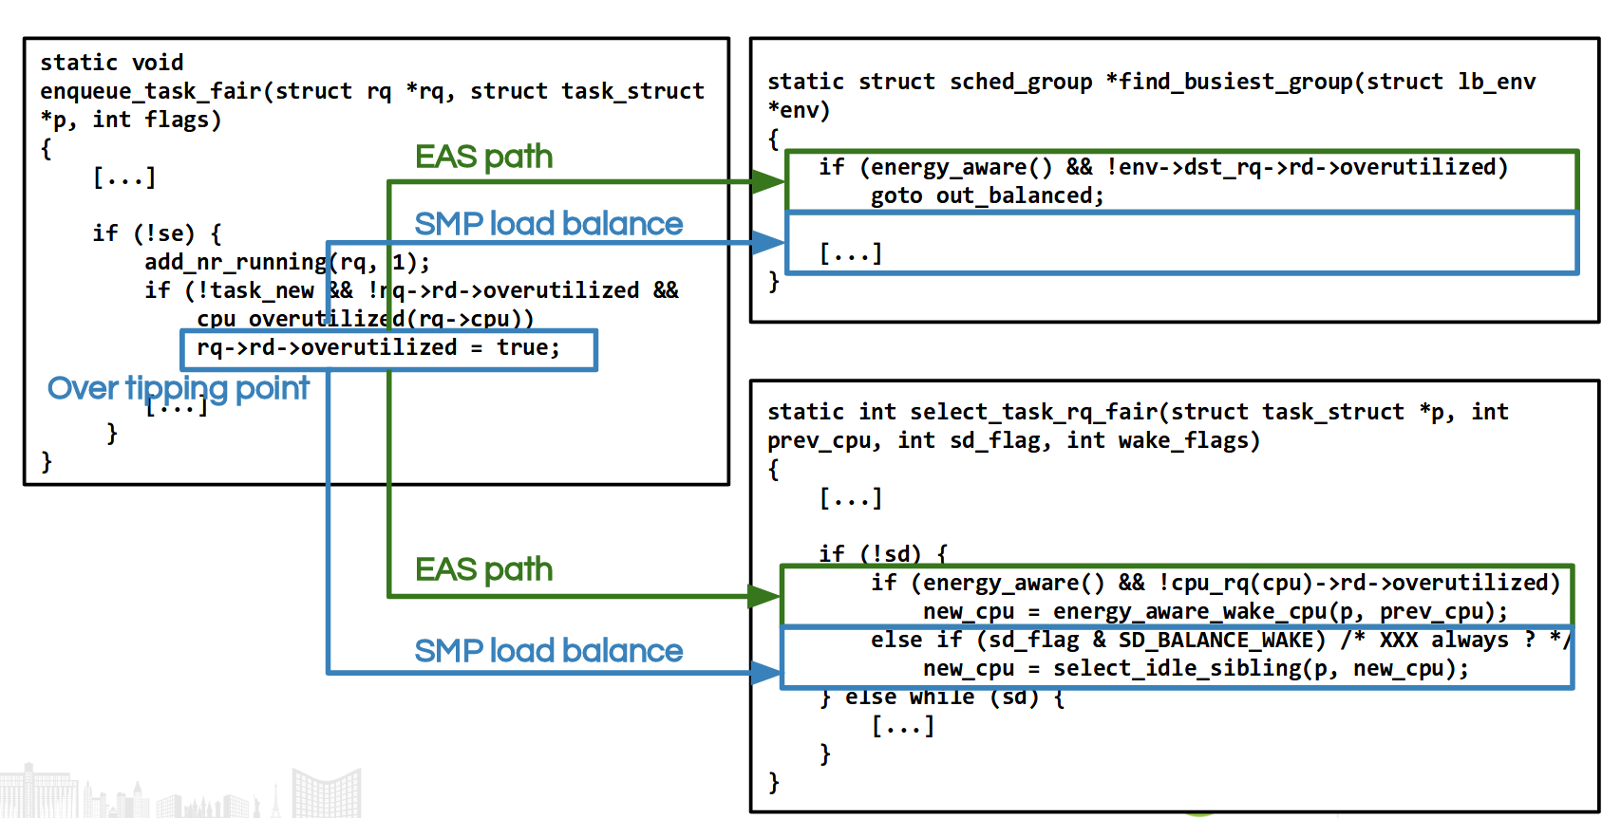
over-utilized

Slide 38
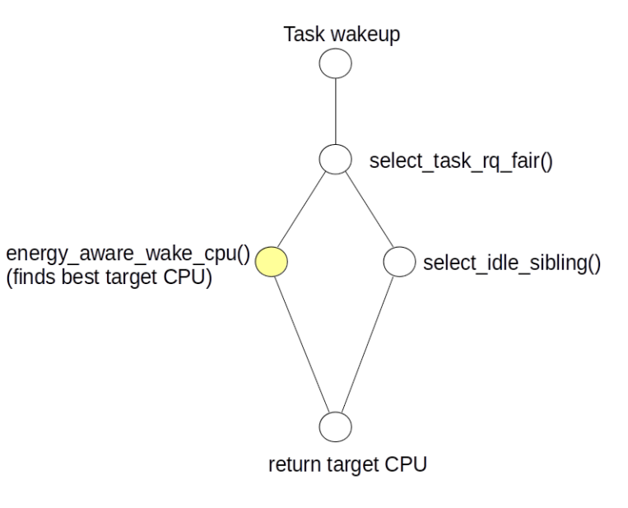
energy_aware_wake_cpu
"EAS Overview and Integration Guide”, ARM TR

Slide 39
select_task_rq_fair()
kernel/sched/fair.c

Slide 40

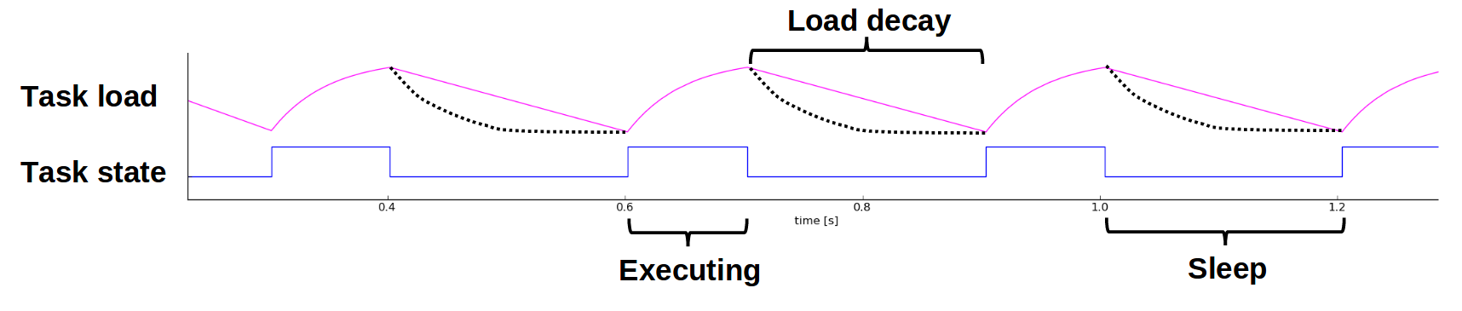
Problem - PELT+EAS
Responsiveness problem.
Consider web browsing in mobile world.
The load does not rise quickly enough.

Slide 41
Solution
Use Window Aissisted Load Tracking scheme(WALT)

Slide 42
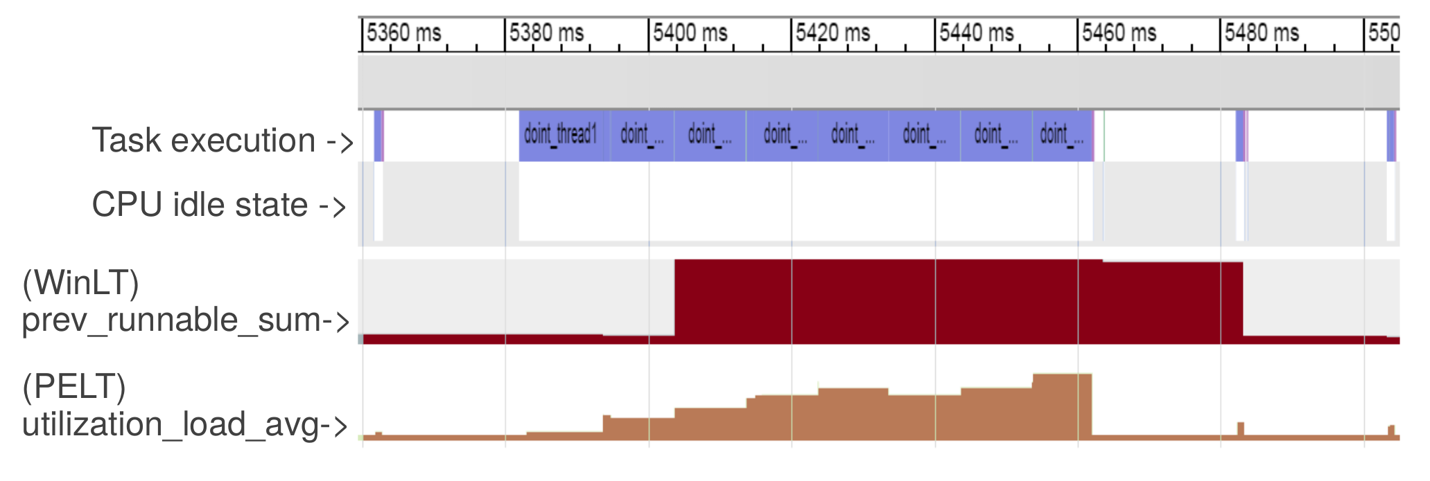
PELT and WinLT
https://www.slideshare.net/linaroorg/bkk16208-eas

Slide 43
Solution
Use Window Aissisted Load Tracking scheme(WALT)
WALT
Problem : Lock + Cache coherency
Solution
new PELT Load tracking algorithm

Slide 44
EAS building blocks
"EAS Overview and Integration Guide”, ARM TR

Slide 45
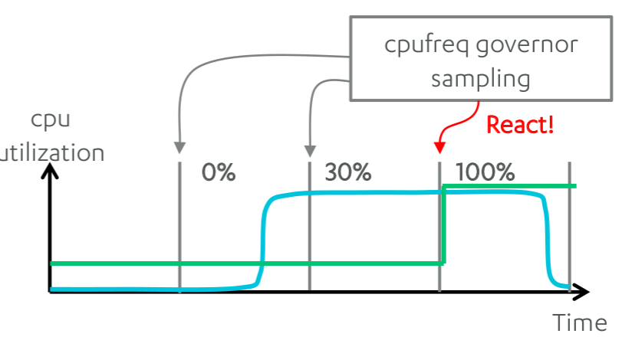
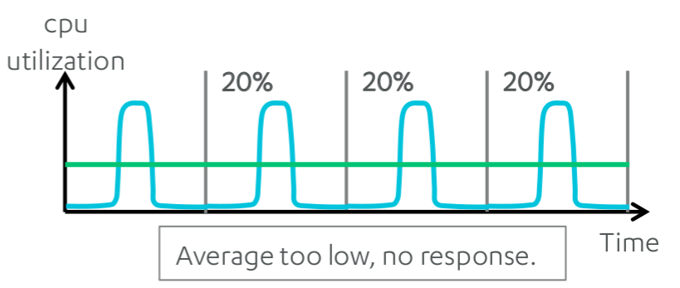
Problem - Timer-based DVFS
Problem
Sampling based governors are slow to respond and hard to tune.
Sampling too fast
Freq changes for small utilization spikes.
Sampling too slow
Average too low
"EAS Update", Amit Kucheria et. ,al. ARM

Slide 46
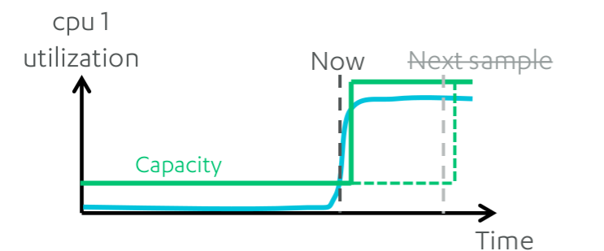
Solution
Use scheduler-based DVFS
Scheduler task utilization tracking DVFS
Immediately when CPU utilization changes
improved responsiveness.
"EAS Update", Amit Kucheria et. ,al. ARM

Slide 47
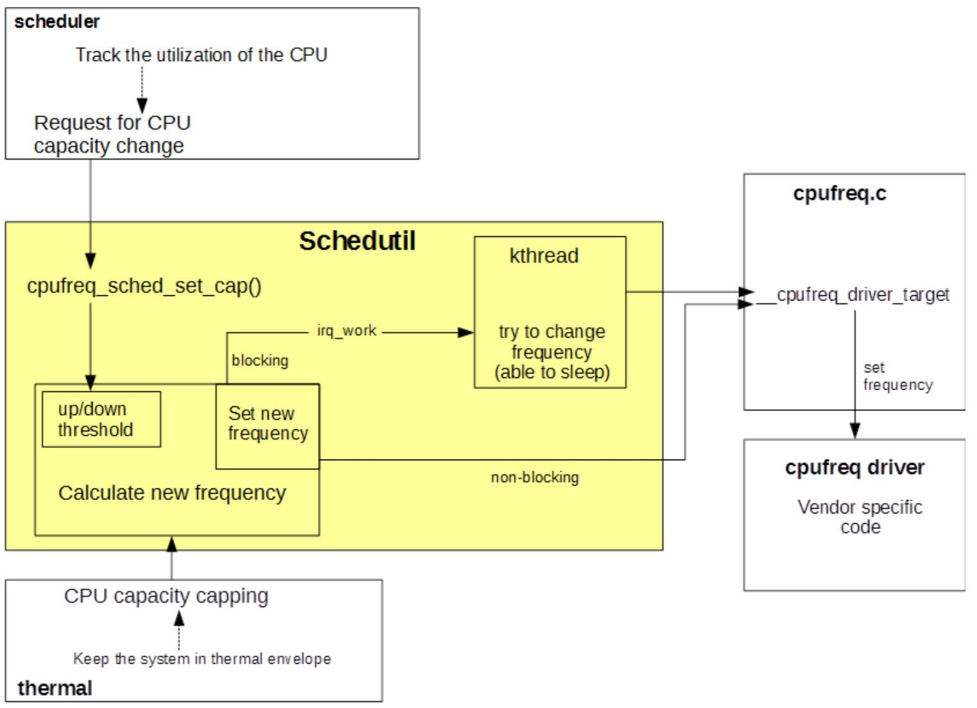
Schedutil
"EAS Overview and Integration Guide”, ARM TR

Slide 48
Problem - Android
Sometimes response time is crucial to the users.
Scheduler
Cannot give user’s experience information.

Slide 49
Solution
Use SchedTune
A way of to provide user’s experience information.
Implemented as a control-group controller.
Each control group has a single tunable knob.
schedtune.boost

Slide 50
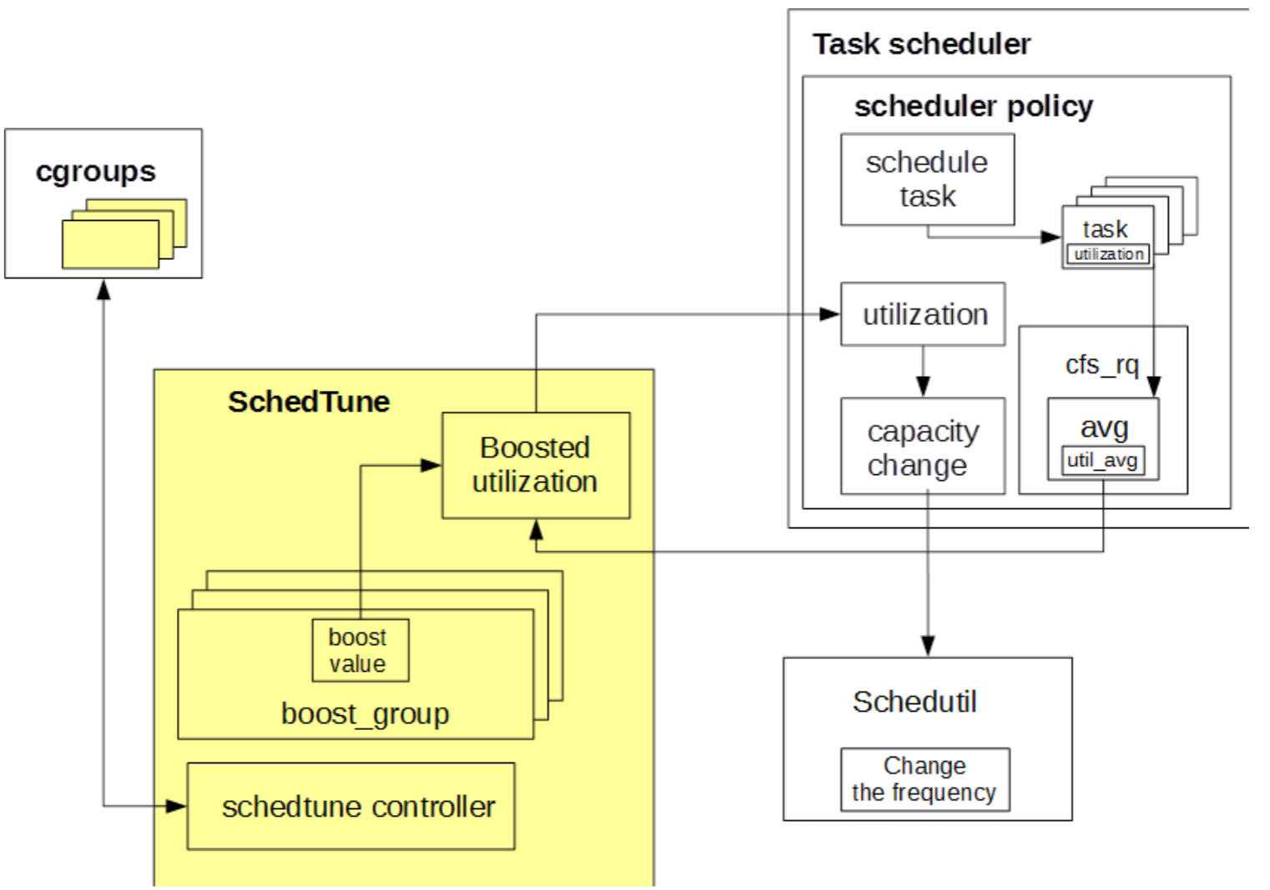
SchedTune

Slide 51
Create energy-aware scheduler tuning nodes
mkdir /dev/stune
mount cgroup none /dev/stune schedtune
mkdir /dev/stune/foreground
mkdir /dev/stune/background
mkdir /dev/stune/top-app
chown system system /dev/stune
chown system system /dev/stune/foreground
chown system system /dev/stune/background
chown system system /dev/stune/top-app
chown system system /dev/stune/tasks
chown system system /dev/stune/foreground/tasks
chown system system /dev/stune/background/tasks
chown system system /dev/stune/top-app/tasks
chmod 0664 /dev/stune/tasks
chmod 0664 /dev/stune/foreground/tasks
chmod 0664 /dev/stune/background/tasks
chmod 0664 /dev/stune/top-app/tasks

Slide 52
Reference
https://pdos.csail.mit.edu/6.828/2016/schedule.html
http://web.mit.edu/6.033
http://www.rdrop.com/~paulmck/
“Is Parallel Programming Hard, And If So, What Can You Do About It?”
Davidlohr Bueso. 2014. Scalability techniques for practical synchronization primitives. Commun. ACM 58
http://queue.acm.org/detail.cfm?id=2698990
"CPUFreq and The Scheduler Revolution in CPU Power Management", Rafael J. Wysocki
https://sites.google.com/site/embedwiki/oses/linux/pm/pm-qos
https://intl.aliyun.com/forum/read-916
User-level threads : co-routines
http://www.gamedevforever.com/291
https://www.youtube.com/watch?v=YYtzQ355_Co
Scheduler Activations
https://cgi.cse.unsw.edu.au/~cs3231/12s1/lectures/SchedulerActivations.pdf
https://en.wikipedia.org/wiki/FIFO_(computing_and_electronics)
http://jake.dothome.co.kr/
http://www.linuxjournal.com/magazine/completely-fair-scheduler?page=0,0
https://www2.cs.uic.edu/~jbell/CourseNotes/OperatingSystems/6_CPU_Scheduling.html
"Energy Aware Scheduling", Byungchul Park, LG Electronic
“Update on big.LITTLE scheduling experiments”, ARM
“EAS Update” 2015 september ARM
"EAS Overview and Integration Guide”, ARM TR
“Drowsy Power Management”, Matthew Lentz, SOSP 2015
https://www.slideshare.net/nanik/learning-aosp-android-hardware-abstraction-layer-hal
https://www.youtube.com/watch?v=oTGQXqD3CNI
https://www.youtube.com/watch?v=P80NcKUKpuo
https://lwn.net/Articles/398470/
“SCHED_DEADLINE: It’s Alive!”, ARM, 2017

